Slide 1

Insight from Reinforcement Learning: A study of risky choices decision-Making

Slide 2
Original Task
wall
guillotine door
cues
reward
start
1/8

Slide 3
Original Task
Expectation = 20
Expectation = 60
+20
100%
0 +40
50% 50%
+60
100%
+40 +80
50% 50%
or
or
Decision: equal expectation
Catch: different expectation
2/8

Slide 4
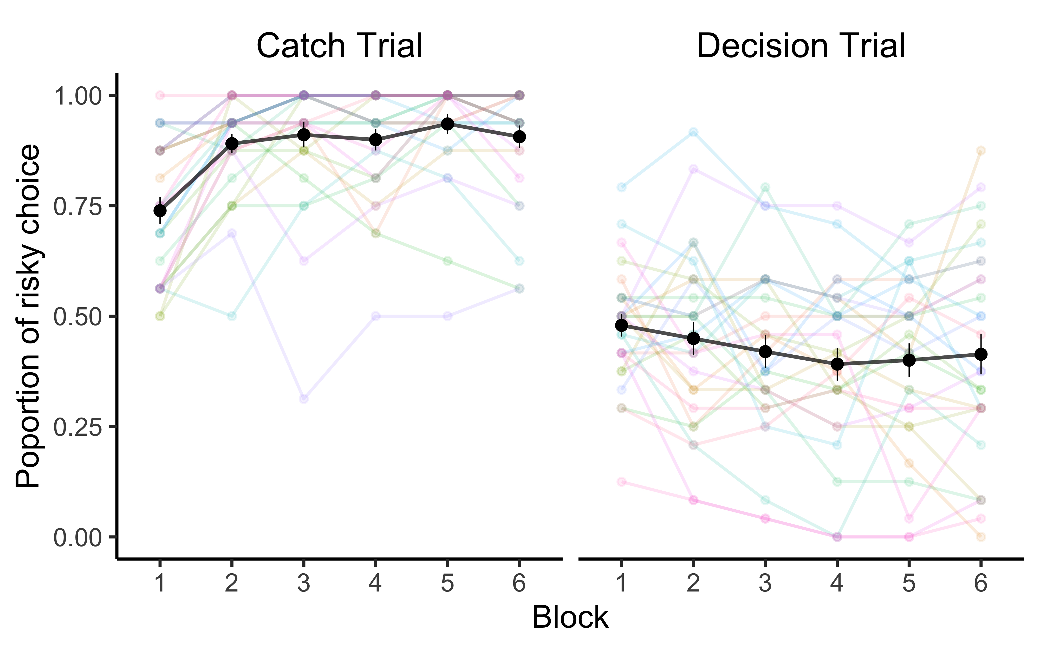
Human Behaviour
3/8

Slide 5
Markov Decision Process
a₁
a₂
a₃
a₄
p=1
p=0.5
p=0.5
p=1
p=0.5
p=0.5
S₁₌0
S₂₌20
S₃₌40
S₄₌60
S₅=80
4/8

Slide 6
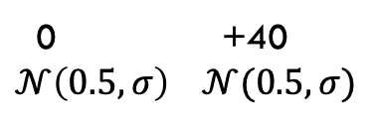
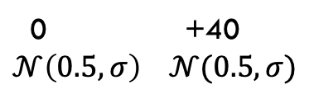
Blurry Probability Task
Expectation = 20
Expectation = 60
+20
100%
0 +40
$$𝒩\left(0.5, σ\right) 𝒩(0.5, σ)$$
+60
100%
0 +40
$$𝒩\left(0.5, σ\right) 𝒩(0.5, σ)$$
or
or
Decision: equal expectation
Catch: different expectation
5/8

Slide 7
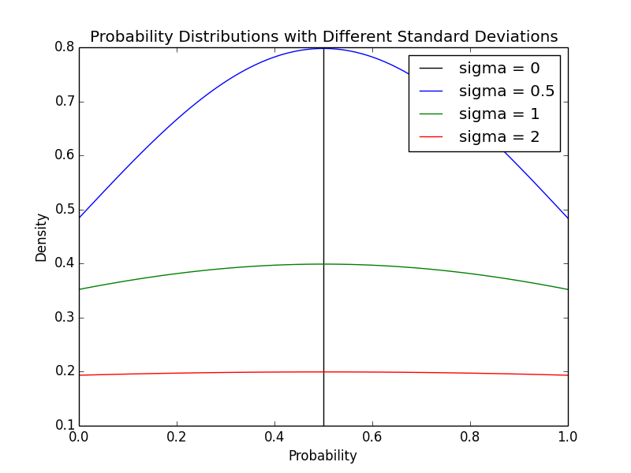
Blurry Probability Task
less risky, more information
more risky, less information
6/8

Slide 8
Project steps
Construct Python environment and RL algorithms.
Imitate the human data by training the algorithms.
Transfer trained algorithms to a blurry probability environment.
Predict the human behaviour in the blurry task.
7/8

Slide 9
Hypotheses
The averaged proportion of risky choice in the catch trials will be lower and closer to that of the decision trials.
The learning phase will be longer.
Individual plot display more zig-zag features .
8/8

